Slide 1
Working Scientifically
ITTECF reference – Standard 3 – Demonstrating good subject and curriculum knowledge.

Slide 2
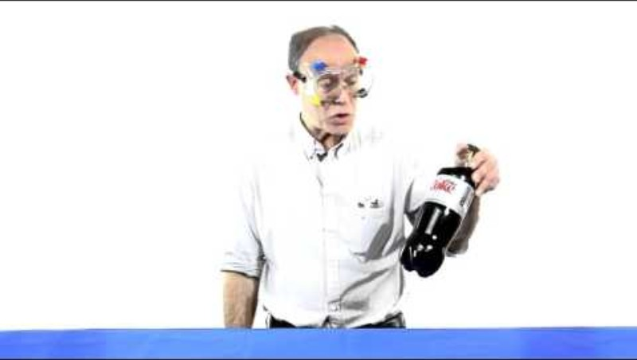
A good science practical?
Think about is this a useful science experiment to promote learning? Why?

Slide 3
Working scientifically skills in the National Curriculum (DfE 2015)
National curriculum in England: science programmes of study - GOV.UK

Slide 4
The progression of skills looks like the following continuum:​
Teacher - led
Modelled Investigation
Semi - independence
Modelled Investigation
Independent
Carry out investigation
Use skills
Begin to use skills

Slide 5
However, it is not so linear it is cyclical.
When a ‘new’ version of a skill is introduced e.g when drawing a line-graph (recording results) for the first time this will obviously be teacher-led (modelled) despite that the child might be capable of drawing their own tables (a different version of recording).
Teacher-led
Semi independent
Independent

Slide 6
Using graph drawing as an example:​
1. Draw a graph of your results. Independent.​
2.​ What measurements will you be using along the horizontal/vertical section of graph?​
What should we start and finish with?​ Semi – independent.
3. Provide students with a graph already calibrated and they plot their answers​. Teacher – led.

Slide 7

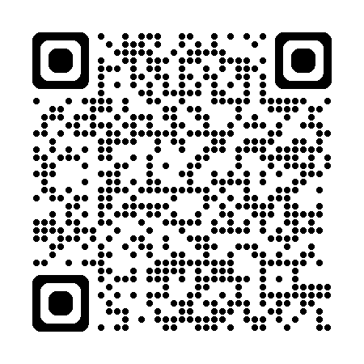
Task
Design a practical that:
Requires pupils to plan an investigation (e.g. identify and control variables, make predictions).
Involves systematic measurement and recording, using correct SI units.
Emphasises conclusions, explaining data, and discussing error and reliability.
Incorporates risk assessment and discussion of scientific attitudes.
National curriculum
BBC bitesize

Slide 8
Considerations
Question to investigate
Background science (relevant knowledge/concepts)
Aim of the investigation
Variables: independent, dependent, and control
Equipment required
Method (procedure, including diagrams)
Risk assessment and safety considerations.

Slide 9
Example Activity: Investigating the Effect of Temperature on Diffusion Rate
A model example for KS3 is the "rate of diffusion" practical, which comprehensively builds working scientifically skills. In this activity, pupils investigate how temperature affects the rate at which food colouring spreads in water. This practical requires students to plan, observe, measure, record, and analyse data, and explicitly links to the KS3 working scientifically framework.
https://thescienceteacher.co.uk/investigations/

Slide 10
Overview
Enquiry Question: How does water temperature affect the rate at which food dye diffuses?
Scientific skill focus: Asking questions, predicting, planning, identifying and controlling variables, measuring, recording, analysing data, and evaluating evidence.
Safety: Care with hot water.

Slide 11
Procedure
Pose the Question
Pupils consider how temperature could influence the rate of diffusion.
Make predictions with scientific reasoning.
Plan the Investigation
Decide which variables to change (independent: water temperature) and which to keep the same (control: dye volume, type, beaker size, water volume).
Plan how to observe and record the dependent variable (rate/time for colour to diffuse a set distance).
Conduct the Experiment
Measure water volumes into beakers at different temperatures (e.g., ice cold, room temp, warm).
Add a drop of food colouring and time how long it takes to reach a specific point or to reach uniform colour.
Record and Present Data
Create a results table. Plot data on a graph of time versus temperature.
Analyse and Conclude
Identify trends. Relate findings back to scientific theory (particle theory).
Draw conclusions and evaluate: Were results reliable and valid? Any sources of error?
Evaluate
Discuss improvements, possible sources of error, and implications for real-life systems.
Link to skills such as reproducibility and repeatability.

